Slide 1

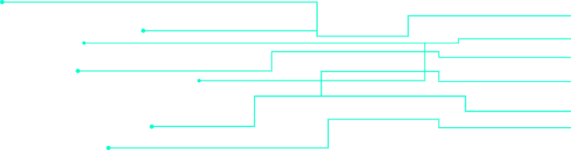
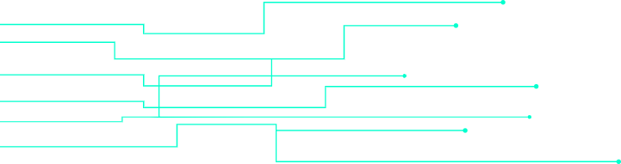
Movies Recommendation system
Major assignment Presentation
Prepared By: Muhammad Haseeb

Slide 2
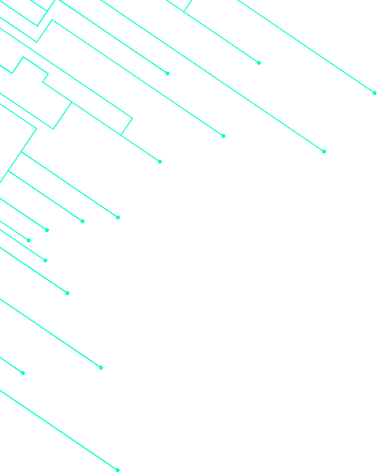


01
Objectives
02
Techniques
Table of Contents
03
Results
04
Challenges

Slide 3

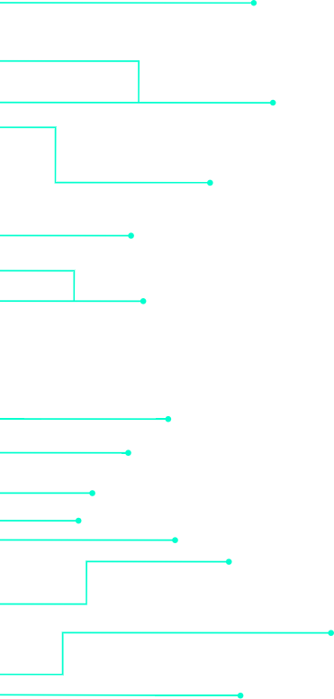
Objective of the project:
The objective of this project is to design and implement a movie recommendation system that provides accurate and personalized movie suggestions by analyzing user preferences and movie attributes.
This includes:
Applying various machine learning techniques, such as Cosine Similarity, SVD, NCF, and RNN.
Optimizing model performance using evaluation metrics like MAE, RMSE, Precision, Recall, and F1-Score.

Slide 4


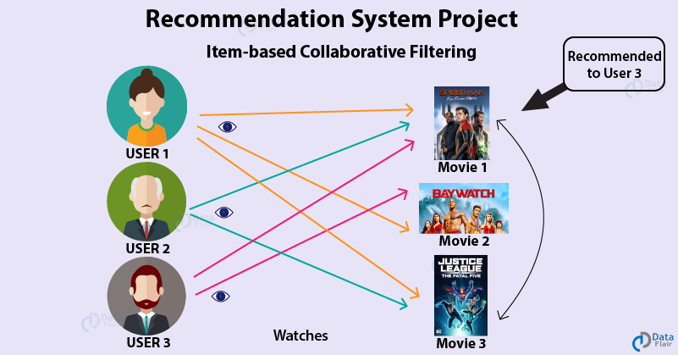



Recommendation system
A recommendation system is an artificial intelligence or AI algorithm, usually associated with Machine learning, that uses Big Data to suggest or recommend additional products to consumers. These can be based on various criteria, including past purchases, search history, information, and other factors.

Slide 5
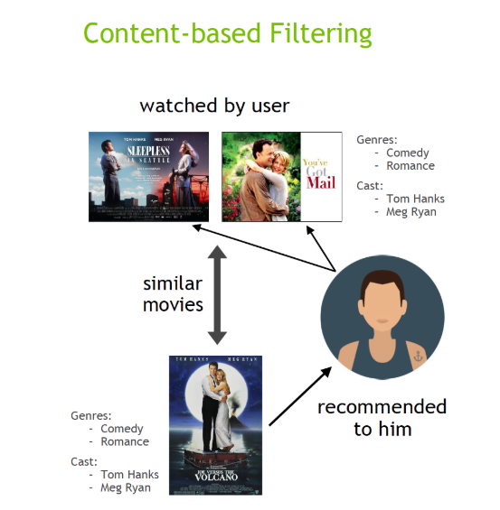
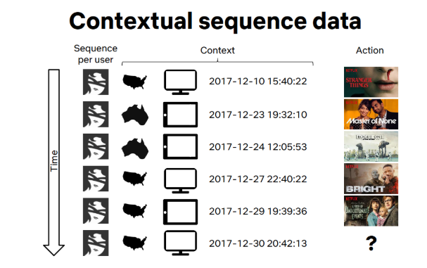
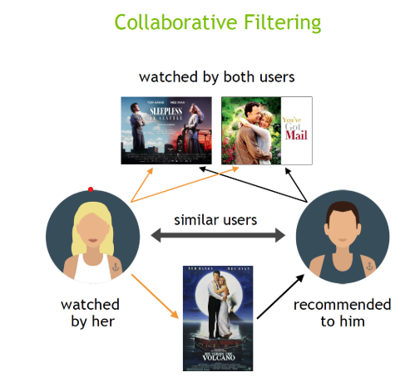

Collaborative Filtering
A Collaborative filtering recommends items by analyzing the preferences of many users. It assumes that users who like similar movie’s in the past, will like similar movie’s in the future.
Content-Based Filtering
Context Aware Filtering
Content-based filtering suggests items based on their attributes or features.
Context-aware systems consider users’ contextual information, such as time, location, or device, to make more relevant recommendations.

Slide 6


Techniques
CS
RNN
SVD
CNF
War

Slide 7
Cosine Similarity
Cosine Similarity is a mathematical technique that measures the similarity between two vectors based on the cosine of the angle between them.It is used in content-based filtering to recommend items similar to a user's preferences by analyzing item features (e.g., genres of movies).
It measure the similarity between items base on their feature (e.g. genres, crew and cast etc).
Recommend movies similar to those a user has already liked.
Example:
Input Movie:
Toy Story (1995)Genres: Animation, Adventure, Comedy
Recommendations:
Bug’s Life (1998) - Animation, Adventure, Comedy
Toy Story 2 (1999) - Animation, Adventure, Comedy
Chicken Run (2000) - Animation, Comedy

Slide 8

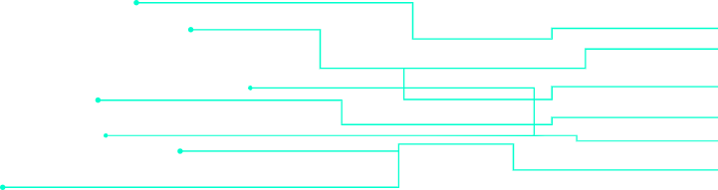
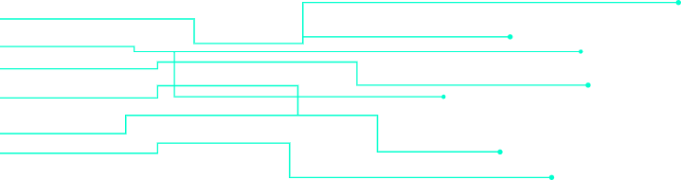
Model Evaluation of CS:
Precision | Recall | F1 Score | Accuracy
0.80 | 1.00 | 0.89 | 0.80

Slide 9
Singular Value Decomposition:
Singular Value Decomposition (SVD) is a matrix factorization technique used in collaborative filtering. It decomposes the user-item interaction matrix into three components:
• U: Captures how much each user aligns with latent features.
• Sigma: Represents the strength of these features.
• V^T: Indicates how much each item aligns with the same latent features.
By computing the dot product of these components, SVD predicts missing ratings, enabling personalized recommendations based on the latent relationships between users and items.
Example:
Input User: User 1310 had already Rated:Star Wars (1977) (Action, Adventure, Fantasy) with rating ( 4.5)
Recommended Movies:
The Godfather (1972) - Crime, Drama
Inception (2010) - Action, Adventure, Sci-Fi
The Dark Knight (2008) - Action, Crime, Drama

Slide 10
Model Evaluation of SVD:
MAE | RSME
1.2472 | 1.5967

Slide 11
Neural Collaborative filtering
The Neural Collaborative Filtering (NCF) model is a neural network that provides collaborative filtering based on user and item interactions. The model treats matrix factorization from a non-linearity perspective. NCF TensorFlow takes in a sequence of (user ID, item ID) pairs as inputs, then feeds them separately into a matrix factorization step (where the embeddings are multiplied) and into a multilayer perceptron (MLP) network.
The outputs of the matrix factorization and the MLP network are then combined and fed into a single dense layer that predicts whether the input user is likely to interact with the input item.
Example:
Input User: User 1
Movies Already Rated:
The Shawshank Redemption (1994) - Rated: 5.0 (Drama, Crime)
Forrest Gump (1994) - Rated: 4.5 (Drama, Romance)
Recommended Movies:
Schindler's List (1993) - Drama, History
The Green Mile (1999) - Crime, Drama, Fantasy
Good Will Hunting (1997) - Drama, Romance

Slide 12
Model Evaluation NCF:
MAE | RSME
0.1597 | 0.2019

Slide 13
(RNNs) are designed for sequential data, making them ideal for capturing temporal patterns in user interactions over time.
Recurrent Neural Network
Recurrent Neural Networks (RNNs) are a class of neural networks designed specifically for sequential data, where the order of inputs significantly impacts the learning process.
Recurrent Neural Networks (RNNs) are a class of neural networks designed specifically for sequential data, where the order of inputs significantly impacts the learning process.
(RNNs) are designed for sequential data, making them ideal for capturing temporal patterns in user interactions over time.
Used in recommendation systems to model user behavior and make context-aware recommendations.
Captures the sequence of user preferences for more accurate predictions. Considers both past interactions and contextual information.
Example:
Input User: User 10
Recent Movie History (in sequence):
The Matrix (1999) - Action, Sci-Fi
Inception (2010) - Action, Adventure, Sci-Fi
Interstellar (2014) - Adventure, Drama, Sci-Fi
Recommended Next Movies:
Tenet (2020) - Action, Sci-Fi,
ThrillerBlade Runner 2049 (2017) - Drama, Sci-Fi,
ThrillerGravity (2013) - Drama, Sci-Fi, Thriller

Slide 14
Model Evaluation of RNN:
MAE | RSME
0.1932 | 0.2433

Slide 15
Challenges:
Dataset Limitation:
we selected the IMDb dataset, but it lacked the features needed for advanced techniques like collaborative filtering.
Then we switched to the MovieLens 1M dataset, which provided sufficient user-item interaction data, but its sparsity (95% missing ratings) made it challenging to train accurate models.
Computational Constraints:
Training advanced models like NCF and RNN was computationally expensive. My system frequently crashed during training due to memory limitations.
Attempts to use Google Colab for cloud-based processing were hindered by poor internet connectivity, slowing down the progress.

Slide 16




Thank you
Credit | Image: Unsplash

